Slide 1
“Opening the Door to Asia”
Gunboat diplomacy: President Fillmore sent naval vessels to Tokyo (1853) after failed negotiations to establish commercial relations
Results in 1854 treaty of “friendship” between U.S. and Japan
Annexation: Hawaiian Islands (1893) and Alaska (1867)
Appealing because of geographically strategic value
Intervention: U.S. forces ousted Spanish from Cuba and the Philippines (1898).
McKinley focuses on Philippines, breaks general rule against colonization (1902).
Did not attempt to colonize Cuba
Open-door policy: Preventive measures in China
U.S. policy makers did not want European powers to carve up China to prevent China from being carved up by European powers (“Scramble for Africa”)
Notes:
So on Monday we discussed the extent to which American foreign policy was primary focused on Westwards expansion, mainly through treaties or outright purchases (Lousiania purchase), small wars fought against European powers (War of 1812, Mexican American War 1846-8), annexation (Texas 1845), ongoing disputes and forceful displacement of native American population.
See the same kind of activism also outside the American continent
Goal was to tap into the enormous markets that existed in Asia.

Slide 2
A Big Stick in Latin America
Theodore Roosevelt: “Speak softly, but carry a big stick.”
1905: Negotiated the end of Russo–Japanese War (and won a Nobel Peace Prize)
1907: Deployed naval armada around the globe to show U.S.'s strength
Believed wars were both inevitable and noble
Ordered military interventions in Dominican Republic (1904), Honduras (1905), Cuba (1906), and Panama (1908)
Proclaimed Roosevelt Corollary in support of Monroe Doctrine
Interested in more history? Dan Carlin’s “The American Peril”
Notes:
Learning Objective: 2.1

Slide 3
Justifying Expansion
Political rationale: Monroe Doctrine detached U.S. from Europe, but strengthened regional hegemony, declaring regional sphere of influence
Moralistic rationale: Manifest Destiny—cultural and religious justification for westward territorial expansion
Economic rationale: Opening new markets, helping commercial sectors with trading partners
Implementing tariffs and low-interest loans to promote U.S. trade
Growing the agricultural sector
Notes:
Learning Objective: 2.1

Slide 4
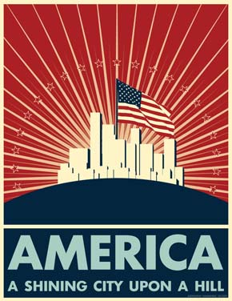
Discussion question:
Was (or is) the U.S. really different from other great powers when it comes to her history of imperialism?

Slide 5
The First World War
1914: European conflicts over territory and nationality
President Wilson attempts to keep U.S. “neutral in fact as well as name”
1915: U.S. national interests threatened by German navy sinking merchant vessels, sinking of the Lusitania
1917: Security concerns lead Congress to declare war against Germany
U.S. contributed to war efforts on two fronts
Provided munitions, weapons, and medical supplies to allies
Deployed reinforcement troops to Western front to relieve British/French troops and stage counteroffensive
1918: Germany surrenders due to U.S. reinforcement measures
Notes:
Learning Objective: 2.2

Slide 6
Failed Efforts to Keep the Peace
Policy makers uncomfortable with security policy based on geopolitics
The distribution of global power should not be tilted too heavily toward one European country (e.g., Germany)
Reason for war linked to diplomatic alliances between European powers.
President Wilson’s moralistic sense of duty
All citizens should be free to determine their own destinies—“Making the world safe for democracy”
“Fourteen Points” outlined steps to world peace, including freedom of markets, seas, governance
Also provided framework for global collective security organization—became the League of Nations
Notes:
Different pushes and pulls that affected U.S. foreign policy making after WWI

Slide 7
Failed Efforts to Keep the Peace
Outcomes of League of Nations:
Congress refuses to ratify treaty, U.S. does not join the organization
Resented Wilson’s unilateral actions during the negotiations of the Treaty of Versailles
.
League fails to intervene when Japan invades Manchuria (China) in 1931 and when Italy invades Ethiopia (1935)
Collective-action and free-rider problems plague organization
Creates a false sense of security
Notes:
Learning Objective: 2.2

Slide 8
The Second World War
1938–1939: Hitler annexes Austria; Czechoslovakia, invades Poland and divides it with Soviet Union
1941: Hitler launches Blitzkrieg against Soviet Union, assumes control of most of Western Europe
During this time, U.S. attempts to remain “neutral,” despite Roosevelt’s desire to aid European democracies
Public opinion divided over isolation or involvement
Lend–lease program: Roosevelt sends military hardware, ships, and supplies to Great Britain
December 7, 1941: Japan attacks Pearl Harbor
Germany and Italy declare war against the United States
Domestic debate between Congress, the public, and the president ends
Notes:
Learning Objective: 2.2

Slide 9
Global Primacy and the Cold War
In the wake of WWII, United States and Soviet Union were only superpowers remaining, resulting in emergence of bipolar balance of power
Cold War based in ideological differences
Capitalist states (led by U.S.) vs. communist states (led by Soviet Union)
Competition to influence markets and countries around the world (spheres of influence)
Notes:
Learning Objective: 2.3

Slide 10
Global Primacy and the Cold War
U.S. State Department specialist George Kennan’s containment strategy as a middle ground between complete detachment and full-scale invasion
Objectives:
Prevent communist expansion into new areas and countries, but accept already existing Soviet areas
Strengthen political, economic, and military ties overseas
Involvement in civil wars and struggles around the world (see next slide, Table 2.2) to promote anti-communist regimes
Notes:
Learning Objective: 2.3

Slide 11
New Structures of Foreign Policy
Following end of WWII, the United States reorganizes and develops new domestic institutions to align with containment doctrine and security state ideals
National Security Act of 1947
Replaces War Department with Department of Defense
Establishes National Security Counsel (NSC)
Forms Central Intelligence Agency (CIA)
Other federal departments also develop intelligence agencies—led to struggles between organizations for resources and power
Little information-sharing between agencies
“Flawed by design”
Notes:
How can you do this? What do you need to become the new super power? Change domestic and international framework for foreign policy making.

Slide 12
New Structures of Foreign Policy
U.S. creates international organizations to preserve power
1944: Bretton Woods institutions extend U.S. ideologies and values into world economic markets
Creation of World Bank, International Monetary Fund (IMF)
1947: Truman Doctrine extends military and economic aid to Greece and Turkey to combat communist aggression and insurgency
1947: Marshall Plan develops economic aid for European countries to help them rebuild after World War II
1949: North Atlantic Treaty Organization (NATO) creates military alliance of Western European countries and United States
Notes:
Beginning of the liberal international order.

Slide 13
Regional Conflicts and the Vietnam Syndrome
U.S. policy makers concerned about wide range of issues in post–WWII environment
The relationship between Soviet Union and China (PRC)
Treaty of Cooperation (1950) and threat of nuclear power, communist expansion
Growing number of African and Asian countries in the third world and the potential appeal of communism to these new states
If one country falls to communism in a region, multiple countries will follow suit (domino theory)
Notes:
Learning Objective: 2.3

Slide 14
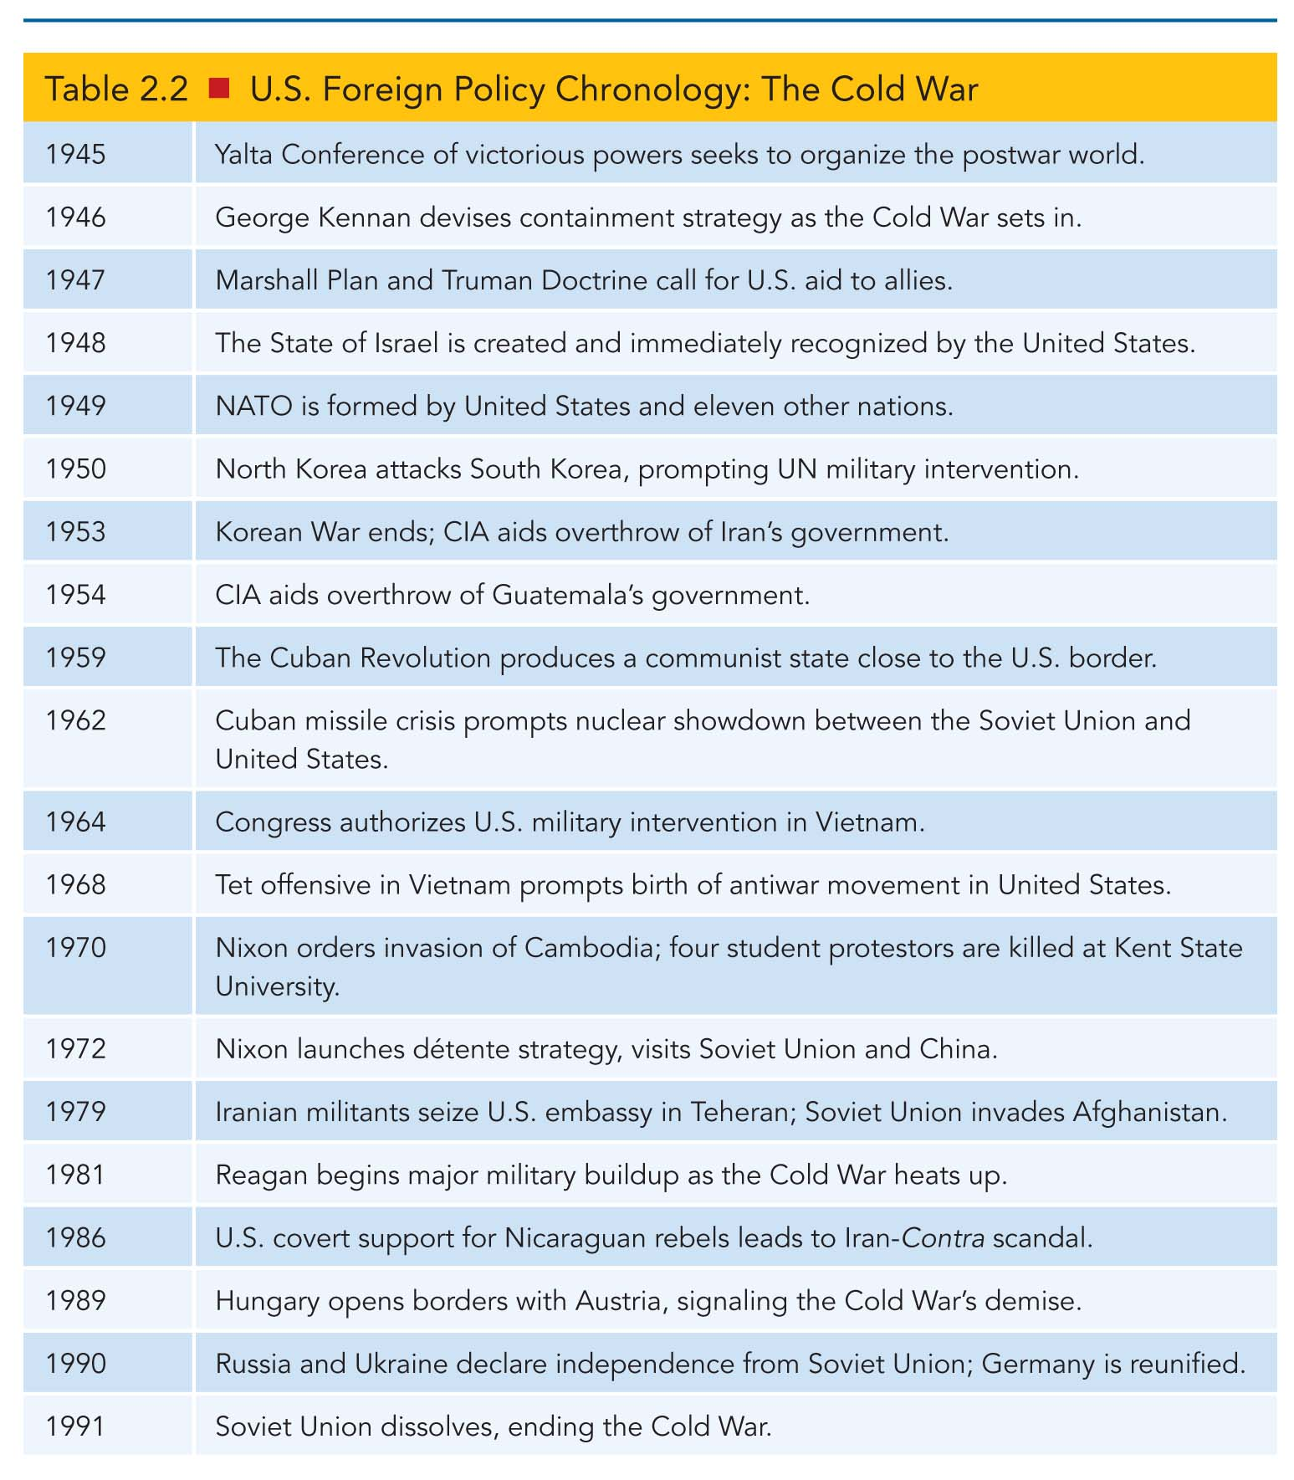
U.S. Foreign Policy Chronology: The Cold War

Slide 15
Korea
1950–1953: North Korea and South Korea in conflict after World War II, divided at the 38th parallel
Truman and Eisenhower deploy troops to help fight against communist insurgency and North Korean troops
No clear victor
Sets precedent for future Cold War conflicts
President Eisenhower’s New Look strategy of massive military (nuclear) buildup
Also included strengthening and expanding alliances, leading to the ANZUS, SEATO, and CENTO treaties
Tied directly to containment policy
War technically continues today
Notes:
Learning Objective: 2.3

Slide 16
Cuba
Closest “hot” country to the United States—less than 100 miles from Florida
1959: U.S.-backed Batista regime overthrown by Marxist regime of Fidel Castro; Castro declares the U.S. to be enemy of the Cuban people
1961: U.S. failed Bay of Pigs invasion marks problems in bureaucracy and intelligence
1962: Cuban missile crisis occurs over Soviet nuclear missiles being secretly shipped to Cuba
Notes:
Learning Objective: 2.3

Slide 17
Vietnam
1964–1972: U.S. supports weak and often corrupt regimes in South Vietnam while fighting against communist insurgents and the North Vietnamese army
U.S. spends billions on war, loses nearly 59,000 troops
U.S. institutions marred with failure
The public, inundated with images and stories of the failures of the war, pushes policy makers to end war
Congress presses Johnson and Nixon
When U.S. withdraws forces, South Vietnam falls to North Vietnam
Vietnam Syndrome: Public believes U.S. should not intervene militarily overseas unless absolutely threatened
Notes:
Learning Objective: 2.3

Slide 18
The End of the Cold War
National Security Adviser Henry Kissinger and President Nixon institute détente—the easing of tensions between the U.S., Soviet Union, China
Agreement for agricultural exports to Soviet Union
Arms reduction deals with Soviet Union
Economic ties strengthened with China
Triangular diplomacy: United States strengthens ties with Soviet Union and China, making adversaries of two enemies
Notes:
Learning Objective: 2.3

Slide 19
The End of the Cold War
1980: President Reagan calls for overpowering the Soviet Union
“The focus of evil in the modern world”
Massive defense and technology buildup in U.S.
Meanwhile, Soviet restructuring of economy and political system under Gorbachev
Soviet bloc begins to fall because of failed economy and political uprising
Bush administration adopts strategy of supporting Gorbachev and a “soft landing” for the Soviet Union to avoid military conflict
Notes:
Learning Objective: 2.3

Slide 20
New Challenges After the Cold War
President George H. W. Bush and the New World Order
Democratization: Expansion of political rights
Economic globalization: Growth of market economy across the world
Multilateral cooperation: Expansion of global institutions and maintenance of order
United States looks to expand economic markets into global markets with limited government regulation
Clinton administration adopts strategy of “engagement and enlargement” by welcoming multilateral coalitions for peacekeeping and democratization
Notes:
Coming back to the new world order and liberal internationalism

Slide 21
Overseas Unrest and Domestic Unease
New World Order and other strategies fail to prevent new military conflicts
Persian Gulf: Operation Desert Storm in Kuwait after Iraqi invasion
Failed states: Ethnic and civil conflicts such as Somalia, Bosnia-Herzegovina, and Kosovo
Limited U.S. intervention based on public opinion and past history of Cold War conflicts
Domestic politics and economic success develop into new unilateralism in U.S. foreign policy, or hostility and ambivalence toward transnational policies/institutions
Congress reduces foreign aid and other spending
Public demands domestic/economic focus
Notes:
Learning Objective: 2.4

Slide 22
September 11 and the War on Terrorism
Bush administration takes unilateralism to new heights before and after 9/11 terrorist attacks in New York and Washington, D.C.
Before 9/11
Nullification of antiballistic missile treaty
Trade tariffs (e.g., steel)
Rejection of Kyoto Protocol
After 9/11
Bush Doctrine: Preemption and primacy in military/economic areas
Tension with UN Security Council
Wars in Afghanistan and Iraq based on Bush Doctrine
Continuing violence leads to surge strategy of U.S. troops in 2007
Notes:
Learning Objective: 2.4

Slide 23
New and Old Problems
2009: President Obama decides to replicate Bush’s surge strategy in Afghanistan
Approximately 9,800 troops still remain (2015) with complete withdrawal anticipated by 2016
President Obama’s foreign policy objectives also hampered by 2007–2009 global financial crisis
2011: Arab Spring uprisings and U.S. intervention in Libya
Withdrawal of troops from Iraq and the rise of ISIS
2014: Renewed tensions between U.S., Russia, and China
Notes:
Learning Objective: 2.4

